Slide 1

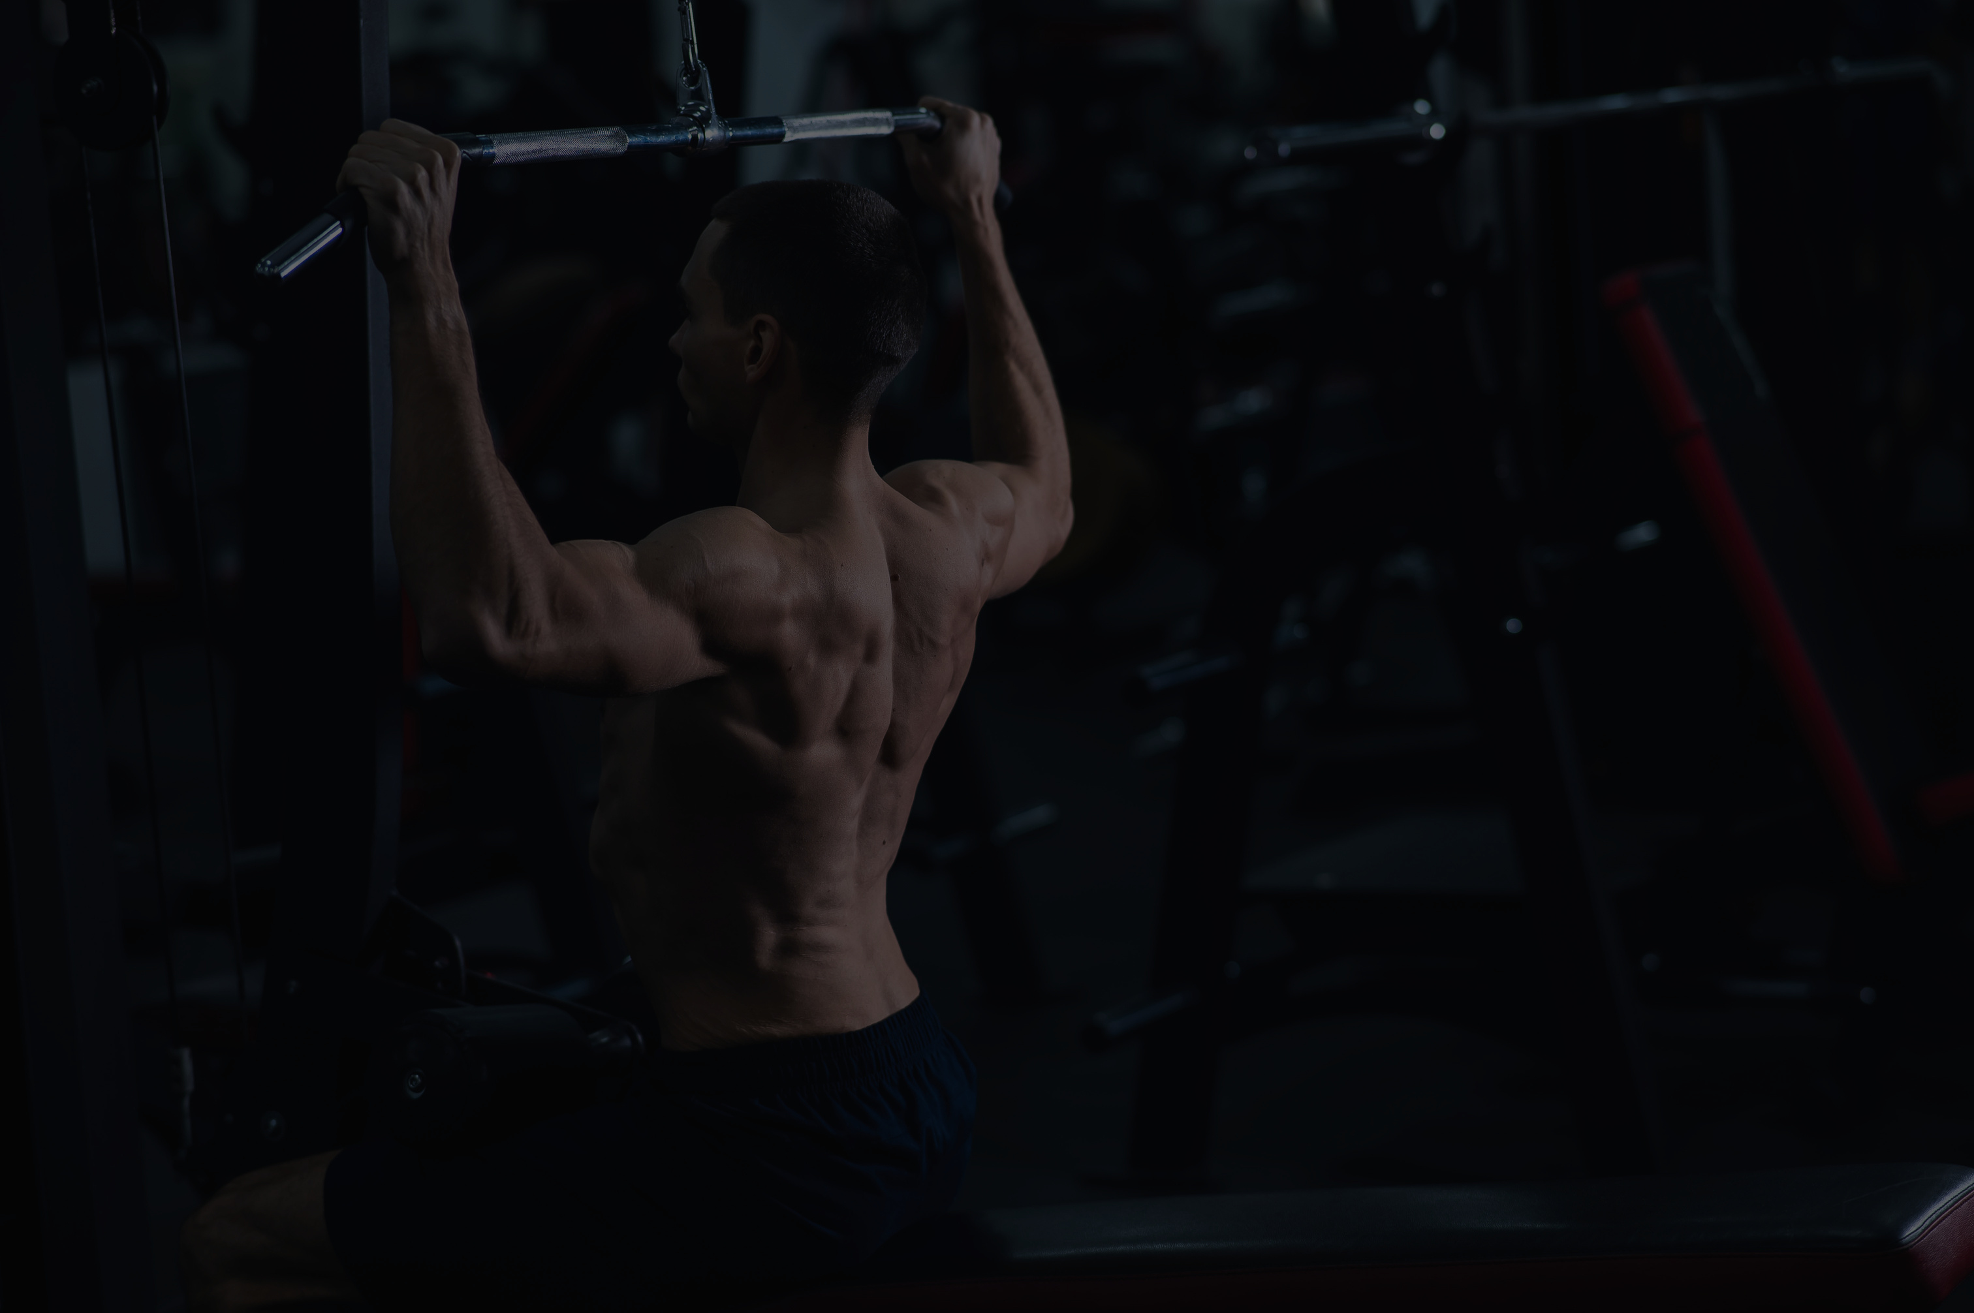

liftology
lift
OLOGY
The AI-POWERED Fitness Application
LIFTOLOGY.COM

Slide 2
MEET OUR TEAM
liftology
Osama Ahmed Hassan
2101435
Mahmoud Taha Mohamed
2100913
Mohammed Motaz Loutfy
2101168
Abdelrahman Mohamed Mahmoud
2100271
Mostafa Adel Kamal
2101318
UNDER THE SUPERVISION OF
Dr. Kamal S. Hamza
T.A. Mohammed Mustafa
Assistant Professor, and Information Technology Program Director at The Egyptian E-Learning University - EELU
Teaching Assistant in Computer and Information Technology at The Egyptian E-Learning University - EELU

Slide 3
liftology
agenda
01
02
03
Introduction
Problem Statment
Problem Solution
04
05
06
Related Work
Implementation
Tools & Technology
07
08
09
Conclusion
Time Plan
Reference

Slide 4
liftology
01
Introduction

Slide 5
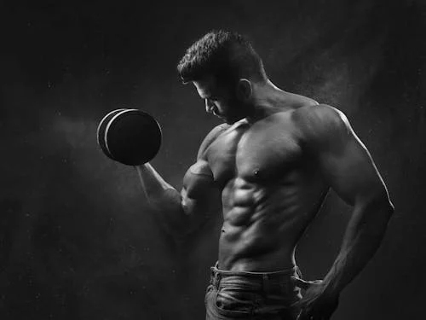
liftology
welcome to
Liftology
In recent years, the demand for personalized fitness solutions has witnessed significant growth, fueled by a heightened awareness of health and wellness. Individuals are increasingly seeking fitness platforms that cater to their unique needs, preferences, and goals. However, traditional fitness applications often rely on generic workout programs and meal plans, failing to adapt to individual progress and personal requirements.
And here, LIFTOLOGY comes into play—an AI-driven fitness app designed to overcome these limitations by leveraging advanced algorithms to develop personalized exercise and nutrition plans. By incorporating training principles such as progressive overload and periodization, Liftology ensures that users can achieve their fitness goals safely and effectively.

Slide 6
liftology
02
Problem Statment

Slide 7
liftology
Many fitness enthusiasts face challenges in staying motivated and reaching their goals due to the absence of personalized guidance.
Current fitness apps often fail to deliver adaptive plans that align with users' evolving progress.
Additionally, improper exercise techniques pose a significant risk of injury, particularly for beginners.
This project seeks to address these challenges by integrating advanced technology with personalized fitness programming, ensuring both safety and effectiveness.

Slide 8
liftology
03
Problem Solution

Slide 9
liftology
AI-Powered Fitness Plan Prediction – Generates personalized workout plans based on weight and height,......etc, ensuring tailored routines.
Personalized Diet Plan Recommender – Is a system designed to suggest diet plans tailored to individual user preferences, health goals, dietary restrictions, and nutritional needs.
Computer Vision for Performance Analysis – Uses CV technology to analyze users’ movements, provide real-time feedback, and correct improper exercise techniques to reduce injury risks.
User-Friendly & Engaging Experience – A simple and interactive interface that encourages consistency and motivation.
By combining technology, predictive fitness planning, and real-time analysis,
this project ensures that users receive the guidance, motivation, and safety
they need to reach their fitness goals efficiently and effectively.

Slide 10
liftology
04
Related Work

Slide 11
Title | Year | Author | Results
Wearables and the Internet of Things (IoT), Applications, Opportunities, and Challenges: A Survey | 2020 | F. John Dian, et al. | The study explored wearables and IoT applications, identifying key opportunities and challenges. It highlighted that over-reliance on wearables excluded non-users and raised privacy concerns, emphasizing the need for inclusive and privacy-conscious approaches in wearable and IoT technologies.
Novel Approach for Real-Time Exercise Posture Correction Using Computer Vision and CNN and Leveraging AI for Exercise Form Assessment | 2023-2024 | IEEE Conference Publications | Explored CNN-based computer vision for real-time exercise posture correction, 92% accuracy in detecting improper form (e.g., squat depth, spinal alignment) using a custom CNN model trained on 10,000 exercise videos,
Criteria for assessing the quality of mHealth apps: a systematic review | 2018 | Nouri et al. | A Systematic review of quality criteria for mHealth apps, focusing on data integration and clinical validity. Only 12% of apps met all criteria for clinical reliability. Apps with integrated AI and sensor data scored 2.8/5 on average for data accuracy, highlighting gaps in multimodal integration.
Injury incidence and specific injury patterns in app-based bodyweight training | 2022 | G Hertel, et al. | The study found 27% of 3,668 fitness app users reported injuries, primarily due to poor form, affecting shoulders, lower back, knees, and wrists. Beginners and intense trainers faced higher risks. Proper technique, professional guidance, and structured warm-up/cool-down routines are essential to reduce injuries in app-based bodyweight training (Hertel et al., 2022).

Slide 12
liftology
LIMITATIONS
1. Poor Multimodal Data Integration (Nouri et al., 2018)
Issue : 72% of apps failed to unify nutrition, exercise, and biometric data, leading to generic plans.
Fix : LIFTOLOGY’s AI integrates all data streams (e.g., adjusts meal plans based on users’ input data).
2. IoT Dependency (Farrokhi et al., 2021)
Issue : Over-reliance on wearables excluded non-users and raised privacy concerns.
Fix : Device-agnostic computer vision (smartphone cameras) and edge computing eliminate IoT needs.
3. Injury Risks & Static Plans (F. John Dian, et al.)
Issue : 27% of users reported injuries from poor exercise form.
Fix : Real-time form correction
Outcome: LIFTOLOGY contributes to bridge research-practice gaps, offering accessible, personalized, and safer fitness guidance.

Slide 13
liftology
05
Implementation

Slide 14
DATASET FOR FITNESS EXERCISES USING BFP & BMI
liftology
This fitness dataset provides personalized exercise plans tailored to individuals' physical features, and gender.
It is designed to assist individuals in achieving their fitness goals by offering customized workout routines that optimize effectiveness and safety.
KEY FEATURES :
Physical Features: The dataset includes physical attributes such as height (h), weight (w), body mass index (BMI), body fat percentage(BFP), and other relevant metrics. These features are crucial for determining an individual's baseline fitness level and guiding exercise recommendations.
Gender: Gender is an essential factor in designing personalized exercise plans. The dataset categorizes individuals into different gender groups to account for physiological differences and tailor workouts accordingly.
Fitness Goals: The dataset allows individuals to set personalized fitness goals such as Exercise plans tailored to help individuals achieve their specific objectives effectively and efficiently.

Slide 15
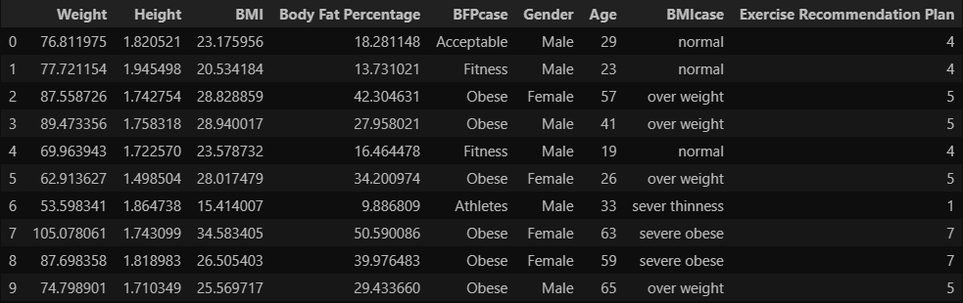
liftology
A quick overview of the dataset to provide insights into its structure, columns, and sample data
Fig 1. Raw dataset
Dataset Structure: The dataset contains 9 columns, each providing specific information about individuals, including their Weight, Height, BMI, BMIcase, Body fat percentage, BFPcase, Gender, Age, and Exercise recommendation plan.

Slide 16
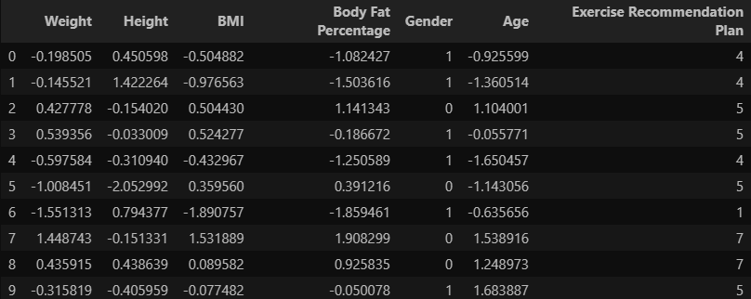
liftology
DATA PREPARATION AND PREPROCESSING
Handling Categorical Data :
Used Label Encoding for Gender, BFPcase, and BMIcase.
Feature Scaling :
Applied StandardScaler to numerical columns (Weight, Height, BMI, etc.).
Dropping Unnecessary Columns :
Removed BFPcase and BMIcase.
Fig 2. Dataset after preprocessing
Splitting method : we used “train_test_split” from scikit-learn library to split the data into 80% training and 20% testing

Slide 17
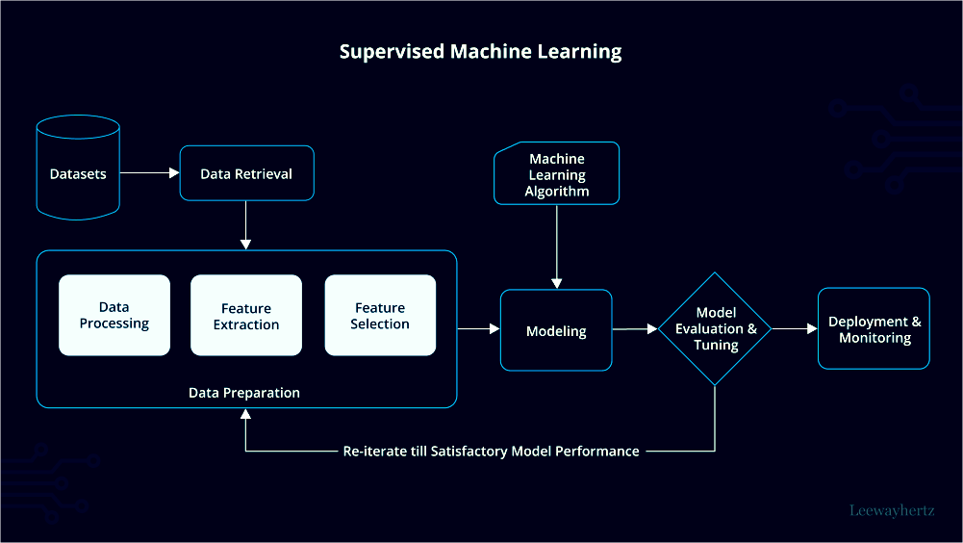
liftology
FITNESS EXERCISES USING BFP & BMI
Using this dataset, we apply a supervised machine learning models to predict the most suitable exercise plan for individuals based on their health and demographic information. Supervised learning involves training a model on a labeled dataset, where the outcome (recommended exercise plan) is known. The model identifies patterns and relationships in the data, enabling it to provide personalized exercise recommendations for new users.
By leveraging supervised machine learning, we can effectively determine the optimal exercise plan using features like weight, height, BMI, body fat percentage, gender, and age. This approach ensures a systematic and data-driven method for tailoring fitness recommendations to individual users.
MODEL USED:
Logistic Regression
Random Forest
Support Vector Machine
Decision Tree
K-Nearest Neighbors
Naive Bayes
XGBoost
Fig. 3. Supervised machine learning process

Slide 18
HYPERPARAMETER OPTIMIZATION
Model | Hyperparameters | Optimal hyperparameters
Logistic Regression | C, penalty, solver | c = 29.763514416313132, penalty = l2, solver = saga
Random Forest | max_depth, n_estimators | max_depth=30, n_estimators=100
Support Vector Machine | C, gamma, kernel | c = 1438.44988828766, gamma=scale, kernel=linear
Decision Tree | criterion, max_depth | criterion = entropy, max_depth=10
K-Nearest Neighbors | metric, n_neighbours, weights | metric = manhattan, n_neighbours = 10, wheights = distance
Naive Bayes | var_smoothing | var_smoothing = 1e-09
XGBoost | colsample_bytree, gamma, learning_rate, max_depth, n_estimators, subsbample | colsample_bytree = 0.6, gamma = 0, learning_rate = 0.01, max_depth = 4, n_estimators = 100, subsbample = 0.8

Slide 19


liftology
Model accuracies

Slide 20
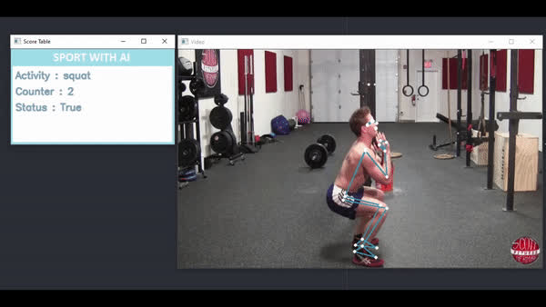
TECHNIQUE DETECTION FOR EXERCISE TRACKING
liftology
Overview:
The technique detection feature in our exercise tracking system leverages computer vision and pose estimation to monitor and evaluate the correctness of exercise techniques in real-time. By analyzing body part angles and joint positions, the system tracks exercises such as push-ups, squats, bicep curls, and shoulder presses, providing users with feedback on their form and counting repetitions accurately.
Implementation:
The system processes video frames in real-time, converting them to RGB for MediaPipe processing, detecting landmarks, calculating angles, and updating exercise counters based on state transitions (e.g., "up" or "down" positions). Visual feedback is rendered using MediaPipe's drawing utilities, displaying landmarks and connections on the video feed, with a score table indicating the exercise type, repetition count, and status.

Slide 21
AI MODEL ARCHITECTURE FOR TECHNIQUE DETECTION
liftology
The core AI component relies on MediaPipe Pose, a lightweight, pre-trained deep learning model for real-time human pose estimation. Its architecture includes:
BlazePose: MediaPipe Pose is built on BlazePose, a convolutional neural network (CNN) optimized for mobile and edge devices. It detects 33 keypoints (landmarks) across the human body, including shoulders, elbows, wrists, hips, knees, and ankles, with high accuracy.
Single-Frame Processing: The model processes each video frame independently, using a combination of heatmap-based keypoint detection and regression to estimate 2D/3D coordinates. This ensures low latency suitable for real-time applications.
Confidence Scores: MediaPipe provides confidence scores for each detected landmark, allowing the system to filter out low-confidence detections (set to a minimum of 0.5 for both detection and tracking in the implementation).
Lightweight Design: The model is optimized for performance, requiring minimal computational resources, making it suitable for deployment on standard hardware without specialized GPUs.

Slide 22
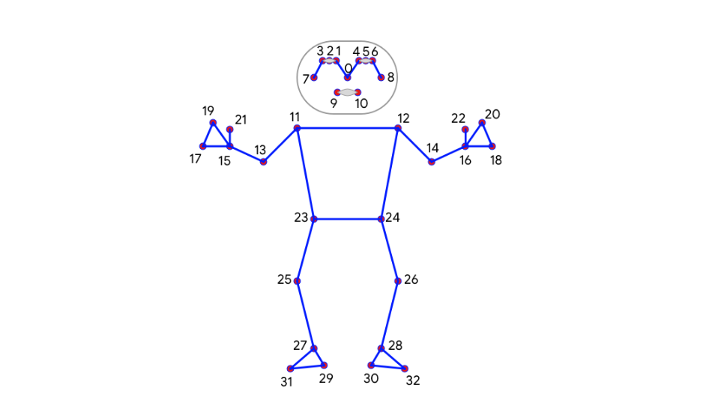
AI MODEL ARCHITECTURE FOR TECHNIQUE DETECTION
liftology
BlazePose keypoint names:
0. Nose, 1. Left eye inner, 2. Left eye, 3. Left eye outer
4. Right eye inner, 5. Right eye, 6. Right eye outer, 7. Left ear
8. Right ear, 9. Mouth left, 10. Mouth right, 11. Left shoulder
12. Right shoulder, 13. Left elbow, 14. Right elbow
15. Left wrist, 16. Right wrist, 17. Leftpinky #1 knuckle
18. Right pinky #1 knuckle, 19. Left index #1 knuckle
20. Right index #1 knuckle, 21. Left thumb #2 knuckle
22. Right thumb #2 knuckle, 23. Left hip, 24. Right hip
25. Left knee, 26. Right knee, 27. Left ankle, 28. Right ankle
29. Left heel, 30. Right heel, 31. Left foot index
32. Right foot index
Fig. 4. 33 Keypoint Topology

Slide 23
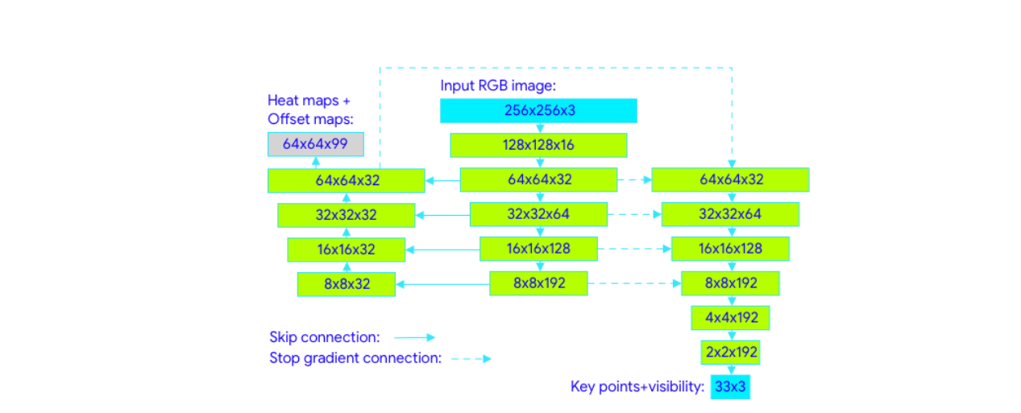
AI MODEL ARCHITECTURE FOR TECHNIQUE DETECTION
liftology
Fig. 5. Network Architecture

Slide 24
TECHNIQUE DETECTION FOR EXERCISE TRACKING
liftology
The approach combines pose estimation with rule-based logic to detect exercise techniques:
1. Pose Estimation: MediaPipe Pose processes each frame to extract 33 landmarks, providing x, y coordinates (and z for 3D estimation, though only 2D is used here).
2. Angle Calculation: The angles at key joints are computed (e.g., elbow for bicep curls, knee for squats) using the arctangent function to determine the angle between three points. For exercises like sit-ups, average positions (e.g., shoulder midpoint) are calculated to assess torso alignment.
3. Exercise-Specific Rules: Each exercise has tailored thresholds:
Squats: Monitors leg angles, incrementing the counter when the average knee angle falls below 70° and resets above 160°.
Bicep Curls: Tracks arm angles, counting a repetition when the average angle exceeds 160° (extended) and drops below 90° (contracted).
Shoulder Press: Evaluates shoulder angles relative to the shoulder midpoint, with thresholds at 100° (down) and 170° (up).

Slide 25
TECHNIQUE DETECTION FOR EXERCISE TRACKING
liftology
4. State Machine: A boolean status variable tracks the exercise phase (e.g., up or down), ensuring accurate repetition counting by detecting transitions between states.
5. Visualization: Landmarks and connections are drawn on the video feed, with a score table overlay displaying the exercise type, repetition count, and status.
Conclusion:
The technique detection feature combines MediaPipe's robust pose estimation with custom rule-based logic to provide accurate, real-time exercise tracking. By leveraging pre-trained models and deterministic thresholds, the system achieves reliable performance without requiring extensive custom datasets or computational resources. This approach makes it accessible for fitness applications, with potential for further refinement to enhance user feedback and adaptability.

Slide 26
liftology
DATASET FOR DIET RECOMMENDATIONS
The recipes dataset contains 522,517 recipes from many categories. This dataset provides information about each recipe like cooking times, servings, ingredients, nutrition, instructions, and more.
Custom diet planning is designed to assist individuals in achieving their health and fitness goals by offering personalized nutrition strategies that optimize effectiveness and long-term success.
KEY FEATURES :
The Dataset has 28 Columns Including:
Nutritional Content: The dataset includes detailed nutritional information such as calories, fat content, saturated fat content, cholesterol content, sodium content, carbohydrate content, fiber content, sugar content, and protein content. These features are essential for understanding the nutritional value of foods and making informed dietary choices.
Dietary Planning: With comprehensive nutritional data, the dataset supports personalized dietary planning. Users can tailor their meal plans based on specific nutritional needs, such as high-protein diets for muscle building or low-carb diets for weight loss.
Allergy and Sensitivity Management: By detailing components like fat and sugar content, the dataset helps individuals with dietary restrictions or sensitivities to avoid certain ingredients and maintain a balanced diet.

Slide 27
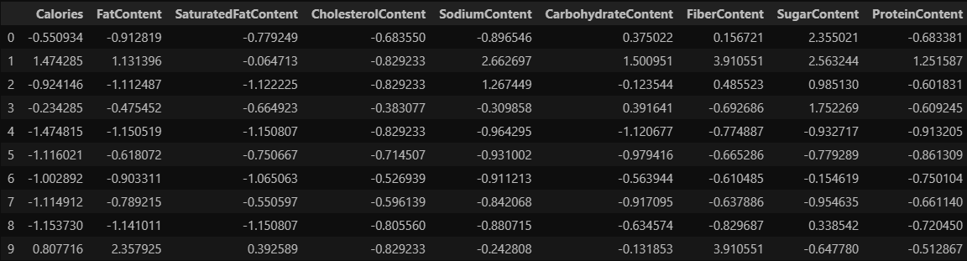
liftology
DATA PREPARATION AND PREPROCESSING
Dropping Unnecessary Columns :
We start by extracting the features that we are interessted in. Since we are building a recommendation engine that takes the recipes nutritional characteristics
Feature Scaling :
Applied StandardScaler to numerical columns (calories, fat content, sodium content, etc.).
Fig 4. Dataset after preprocessing

Slide 28
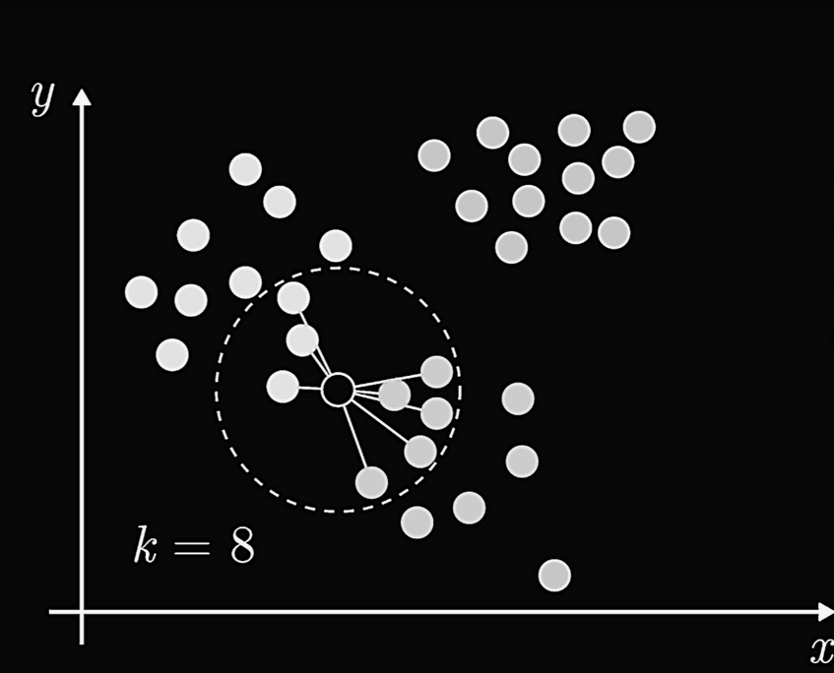
liftology
DIET RECOMMENDATIONS
Why Use Unsupervised Learning?
Unsupervised learning is a type of machine learning where the model is trained on unlabeled data, meaning it does not have predefined categories or target outputs. Instead, the model identifies patterns and similarities within the data.
Since meal recommendations do not have a single “correct” answer (as preferences vary between individuals), this approach helps find meals that are most similar to a user’s preferences based on nutritional features.
How the Recommendation Works:
User Preference Input:
The user provides their desired nutritional goals (e.g., low-fat, high-protein, low-sodium).
This input is converted into a feature vector.
Finding Nearest Meals:
The Nearest Neighbors (NN) algorithm calculates the similarity between the user’s preference vector and all meals in the dataset.
Similarity is typically measured using Cosine similarity.
The algorithm selects the N meals that are closest to the user’s input in terms of nutritional values.
Personalized Meal Recommendations:
The closest meals are presented as recommendations.
Users can adjust their preferences (e.g., reducing carbs or increasing fiber) and receive updated recommendations.
Fig. 5. Nearest Neighbors Algorithm Visualization

Slide 29
liftology
AI CHATBOT
Gen Ai Chatbot Integration
To enhance user engagement and support, we integrated a Gen AI chatbot into the Liftology platform. This chatbot acts as a virtual assistant, offering real-time, intelligent responses to user queries related to fitness, workouts, nutrition, and app features.
Key features:
24/7 Conversational Support
Responds to user questions about their exercise plans, diet recommendations, and general fitness guidance.
Natural Language Understanding
Utilizes the chat model to understand and generate human-like responses, creating an intuitive and interactive user experience.
Context-Aware Conversations
Maintains context across sessions to provide relevant and consistent information.
Integrated with FastAPI Backend
Communicates with our backend to fetch personalized user data and provide informed, real-time feedback.
The chatbot transforms Liftology from just a fitness app into a smart, conversational companion—making fitness guidance more accessible, engaging, and human-like.

Slide 30
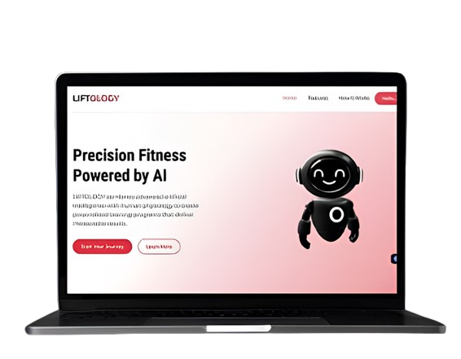
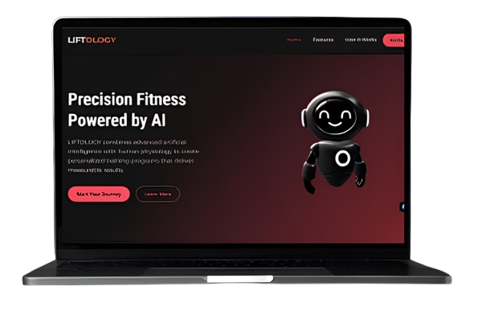
liftology
Liftology Website (demo)
Smart Exercise Recommendations: Analyzes user performance data to deliver personalized workout suggestions, optimizing training and reducing injury risk.
Interactive Fitness Tools: Offers exercise guides and AI-driven coaching, enhancing training efficiency and user engagement.
Responsive and Fast Design: Built with Tailwind CSS, ensuring a seamless and attractive user experience across devices.
Dark and Light Mode Support: Adapts to user preferences with a toggleable interface, improving accessibility and visual appeal.
User Engagement Focus: Addresses the 38% user drop-off risk by prioritizing an attractive, intuitive layout and design.

Slide 31
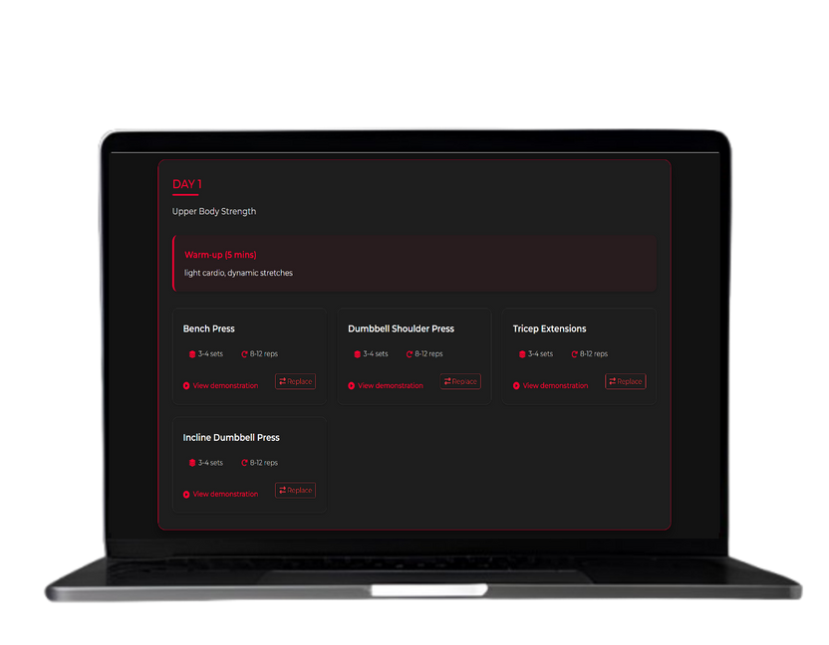
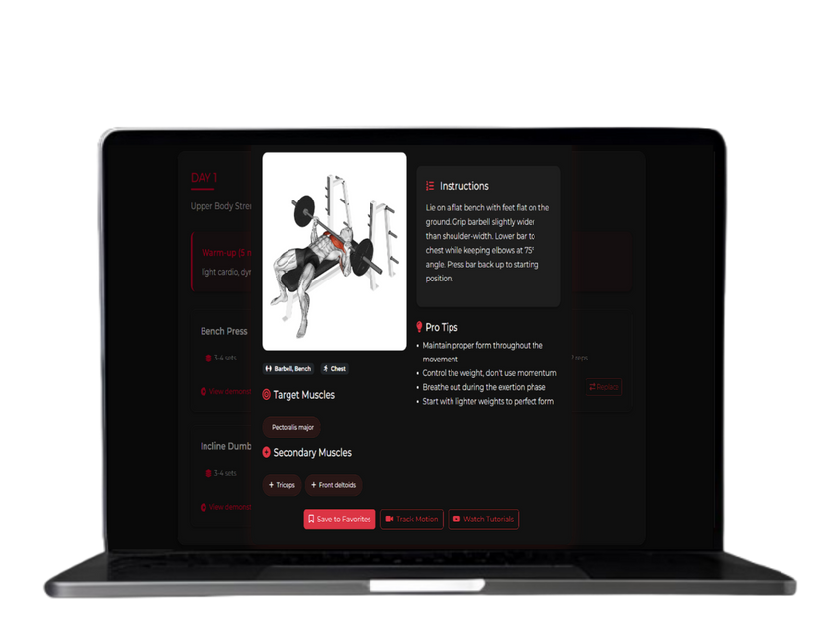
liftology
Exercise plan Page
By incorporating user-specific information, such as fitness goals, experience level, and physical attributes, the platform generates a customized exercise regimen for the week. Each exercise is accompanied by real-time correction guidance, ensuring proper form and maximizing effectiveness. This dynamic, user-centric approach empowers individuals to achieve their fitness goals safely and efficiently, making our webpage a standout tool for personalized fitness planning.

Slide 32
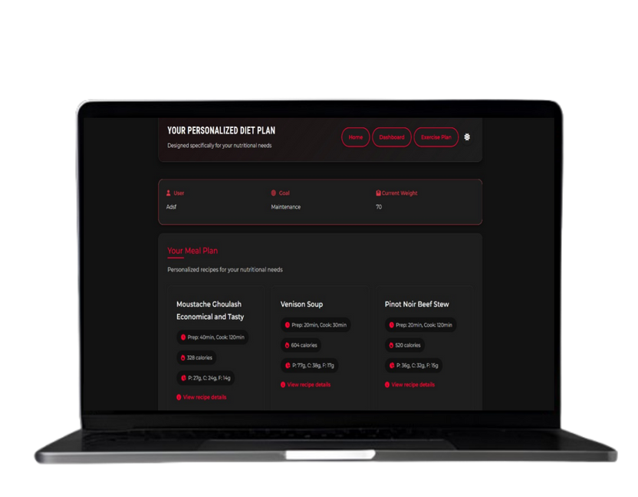
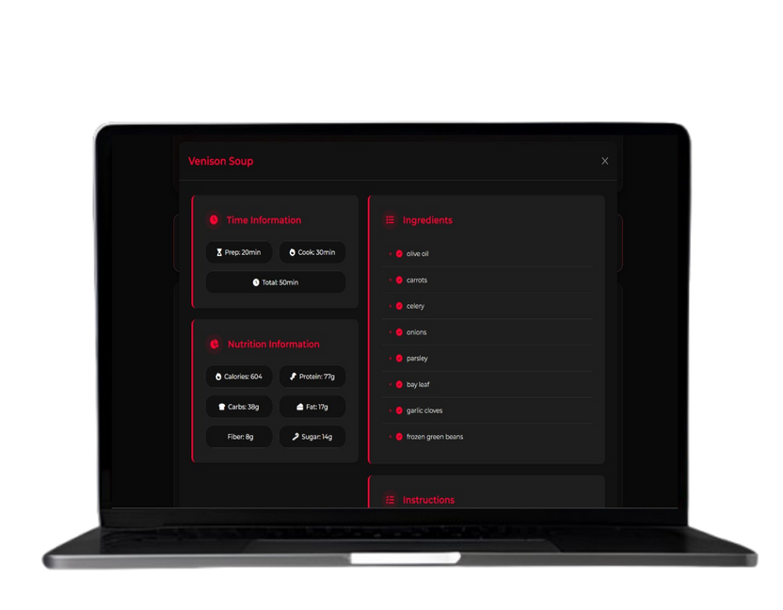
liftology
Diet Plan Page
Our Diet Plan webpage offers a tailored weekly nutrition plan crafted from each user's specific details, such as dietary preferences, health goals, and lifestyle. By analyzing the inputted data, the platform generates a personalized meal schedule, complete with portion recommendations and nutritional guidance to ensure balanced intake. Each plan adapts to the user’s needs, promoting sustainable and effective dietary habits. This user-focused solution makes our webpage an essential tool for achieving personalized wellness goals.

Slide 33
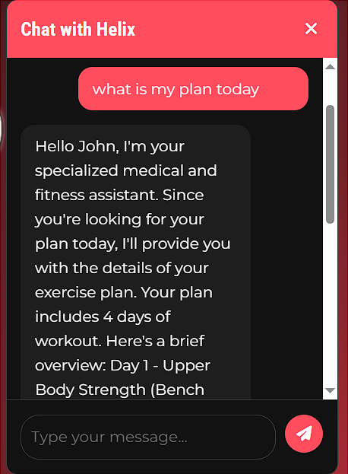
liftology
AI CHAT BOT
Our AI Fitness Chatbot is a personalized virtual coach that supports users in their fitness journey by leveraging their inputted details, such as fitness goals, preferences, and progress. Available 24/7, it provides real-time guidance, answers queries, suggests workout adjustments, and offers motivational tips tailored to the user’s needs. Integrated with our fitness platform, the chatbot enhances user engagement by delivering dynamic, context-aware support, making it an indispensable tool for achieving sustainable fitness success.

Slide 34
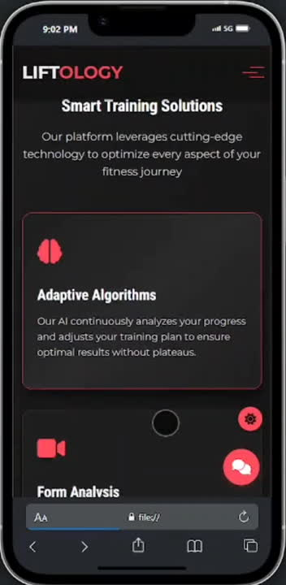
liftology
Responsive Design
Liftology features a fully responsive design, ensuring seamless usability across all devices, from desktops to smartphones. Built with React.js and Tailwind CSS, it adapts dynamically to different screen sizes, providing an optimized experience with smooth navigation and well-structured layouts. Whether users access it on a laptop, tablet, or mobile device, the interface remains fast, intuitive, and visually appealing .
LIFTOLOGY.COM

Slide 35

liftology
Backend integration
To unify all core components of Liftology—exercise plan generation, diet recommendation, and user interaction—we developed a robust backend using FastAPI and MongoDB.
Why FastAPI ?
High performance and asynchronous support for real-time responses.
Easy integration with ML models through API endpoints.
Clean, modular structure ideal for scalable development.
Why MongoDB ?
Flexible document-based database perfect for storing diverse user data (e.g., goals, workout history, dietary preferences).
Efficient handling of dynamic, personalized content.
What We Integrated:
Exercise Plan ML Model: Receives user data via API and returns a tailored workout plan.
Diet Plan ML Model: Suggests meals based on user preferences and nutritional needs.
User Management: Handles registration, login, and secure data storage.
Ai Chatbot: Provides 24/7 virtual assistance, answering user queries about fitness, plans, and progress.
The result: A fully connected system where data flows seamlessly from the frontend to AI modules and back—ensuring a smooth and personalized user experience.
LIFTOLOGY.COM

Slide 36
liftology
06
Tools & Technology

Slide 37
liftology
Tools
ML models
VS Code
Anaconda
Figma
Git
GitHub
Kaggle
Colab
Vercel
Railway
Logistic Regression
Random Forest
Support Vector Machine
Decision Tree
K-Nearest Neighbors
Naive Bayes
XGBoost
technologies
Libraries
Python
HTML/CSS
Tailwind
Mongo DB
FastAPI
Pandas
Numpy
Scikit-learn
XGBoost
Seaborn
Matplotlib
Scipy
SciencePlots
LangChain

Slide 38
liftology
07
Conclusion

Slide 39
liftology
CONCLUSION
Liftology's evaluation of its AI-driven modules demonstrates its effectiveness in delivering personalized workout and nutrition plans, real-time exercise form correction, and conversational support. The results highlight strong model performance, high user engagement, and robust system capabilities, confirming the platform's ability to provide tailored, user-friendly fitness solutions.

Slide 40
liftology
Future Work
Mobile App Development: Launching a mobile app to improve accessibility for mobile-first users.
Biometric Integration: Integrating biometric data from wearables, such as heart rate and calorie burn, to enable more personalized recommendations.
Automated Plan Updates: Automating fitness plan updates based on user progress to reduce manual input and ensure plans evolve with user goals.

Slide 41
liftology
08
Time Plan

Slide 42
Idea Selection | Dataset Selection | Design Planning | Design Implementation | Model Training | Presentation
liftology
6
PHASE 1 TIMELINE
5
4
3
2
Prepare slides, write reports, and present the project
1
Train and fine-tune the AI model for predictions
Define UI/UX design, features, and user flow
Develop front-end and back-end components
Identify the project concept and objectives
Identify the project concept and objectives

Slide 43
liftology
TIMELINE PHASE 1
Sep
oct
nov
dec
mar
jun
IDEA SELECTION
1 Sep - 14 Sep
DATASET SELECTION
15 Sep - 25 Sep
DESIGN PLANNING
26 Sep - 20 Oct
DESIGN IMPLEMENTATION
10 Oct - 30 Oct
2 Feb - 20 Apr
MODEL TRAINING
10 Oct - 31 Dec
2 Feb - 20 Apr
PRESENTAION
1 Jun - 10Jun

Slide 44
Frontend Improvements | Backend Setup Begins | Core Backend Development | Backend–Frontend Integration | AI Features & Final Integration | Testing & Documentation
liftology
6
PHASE 2 TIMELINE
5
4
3
2
Write documentation (how the system works, how to run it)
1
AI Features & Final Integration
Connect frontend to backend APIs (login, register, dashboard)
Develop database schema for users, workouts, progress
Configure database (MongoDB)
Refactor UI/UX based on feedback from Phase 1

Slide 45
liftology
TIMELINE PHASE 2
JAn
Feb
Mars
apr
May
jun
FrontEND IMPROVEMENTS
15Jun - 31Jun
BACKEND SETUP BEGINS
25Jun - 10Feb
CORE BACKEND DEVELOPMENT
12 Feb - 25 Feb
BACKEND–FRONTEND INTEGRATION
12Feb - 20Feb
12Apr - 12May
AI FEATURES & FINAL INTEGRATION
20May - 1Jun
TESTING & DOCUMENTATION
12May - 10Jun

Slide 46
liftology
09
References

Slide 47
liftology
Nouri, R., et al. (2018). Criteria for assessing the quality of mHealth apps: a systematic review. Journal of the American Medical Informatics Association.
2. IEEE Conference Publications [2023–2024]. Novel Approach for Real-Time Exercise Posture Correction Using ..........Computer Vision and CNN and Leveraging AI for Exercise Form Assessment.
3. F. John Dian, et al. (2020) Wearables and the Internet of Things (IoT), Applications, Opportunities, and Challenges: ..........A Survey, IEEE Puplicanions
4. G Hertel, et al. (2022) Injury incidence and specific injury patterns in app-based bodyweight training (Freeletics): .......results of an international survey with 3668 participants, NCBI Pubmed
5. Dataset [1]: https://www.kaggle.com/datasets/mustafa20635/fitness-exercises-using-bfp-and-bmi
6. Dataset [2]: https://www.kaggle.com/datasets/irkaal/foodcom-recipes-and-reviews/data

Slide 48
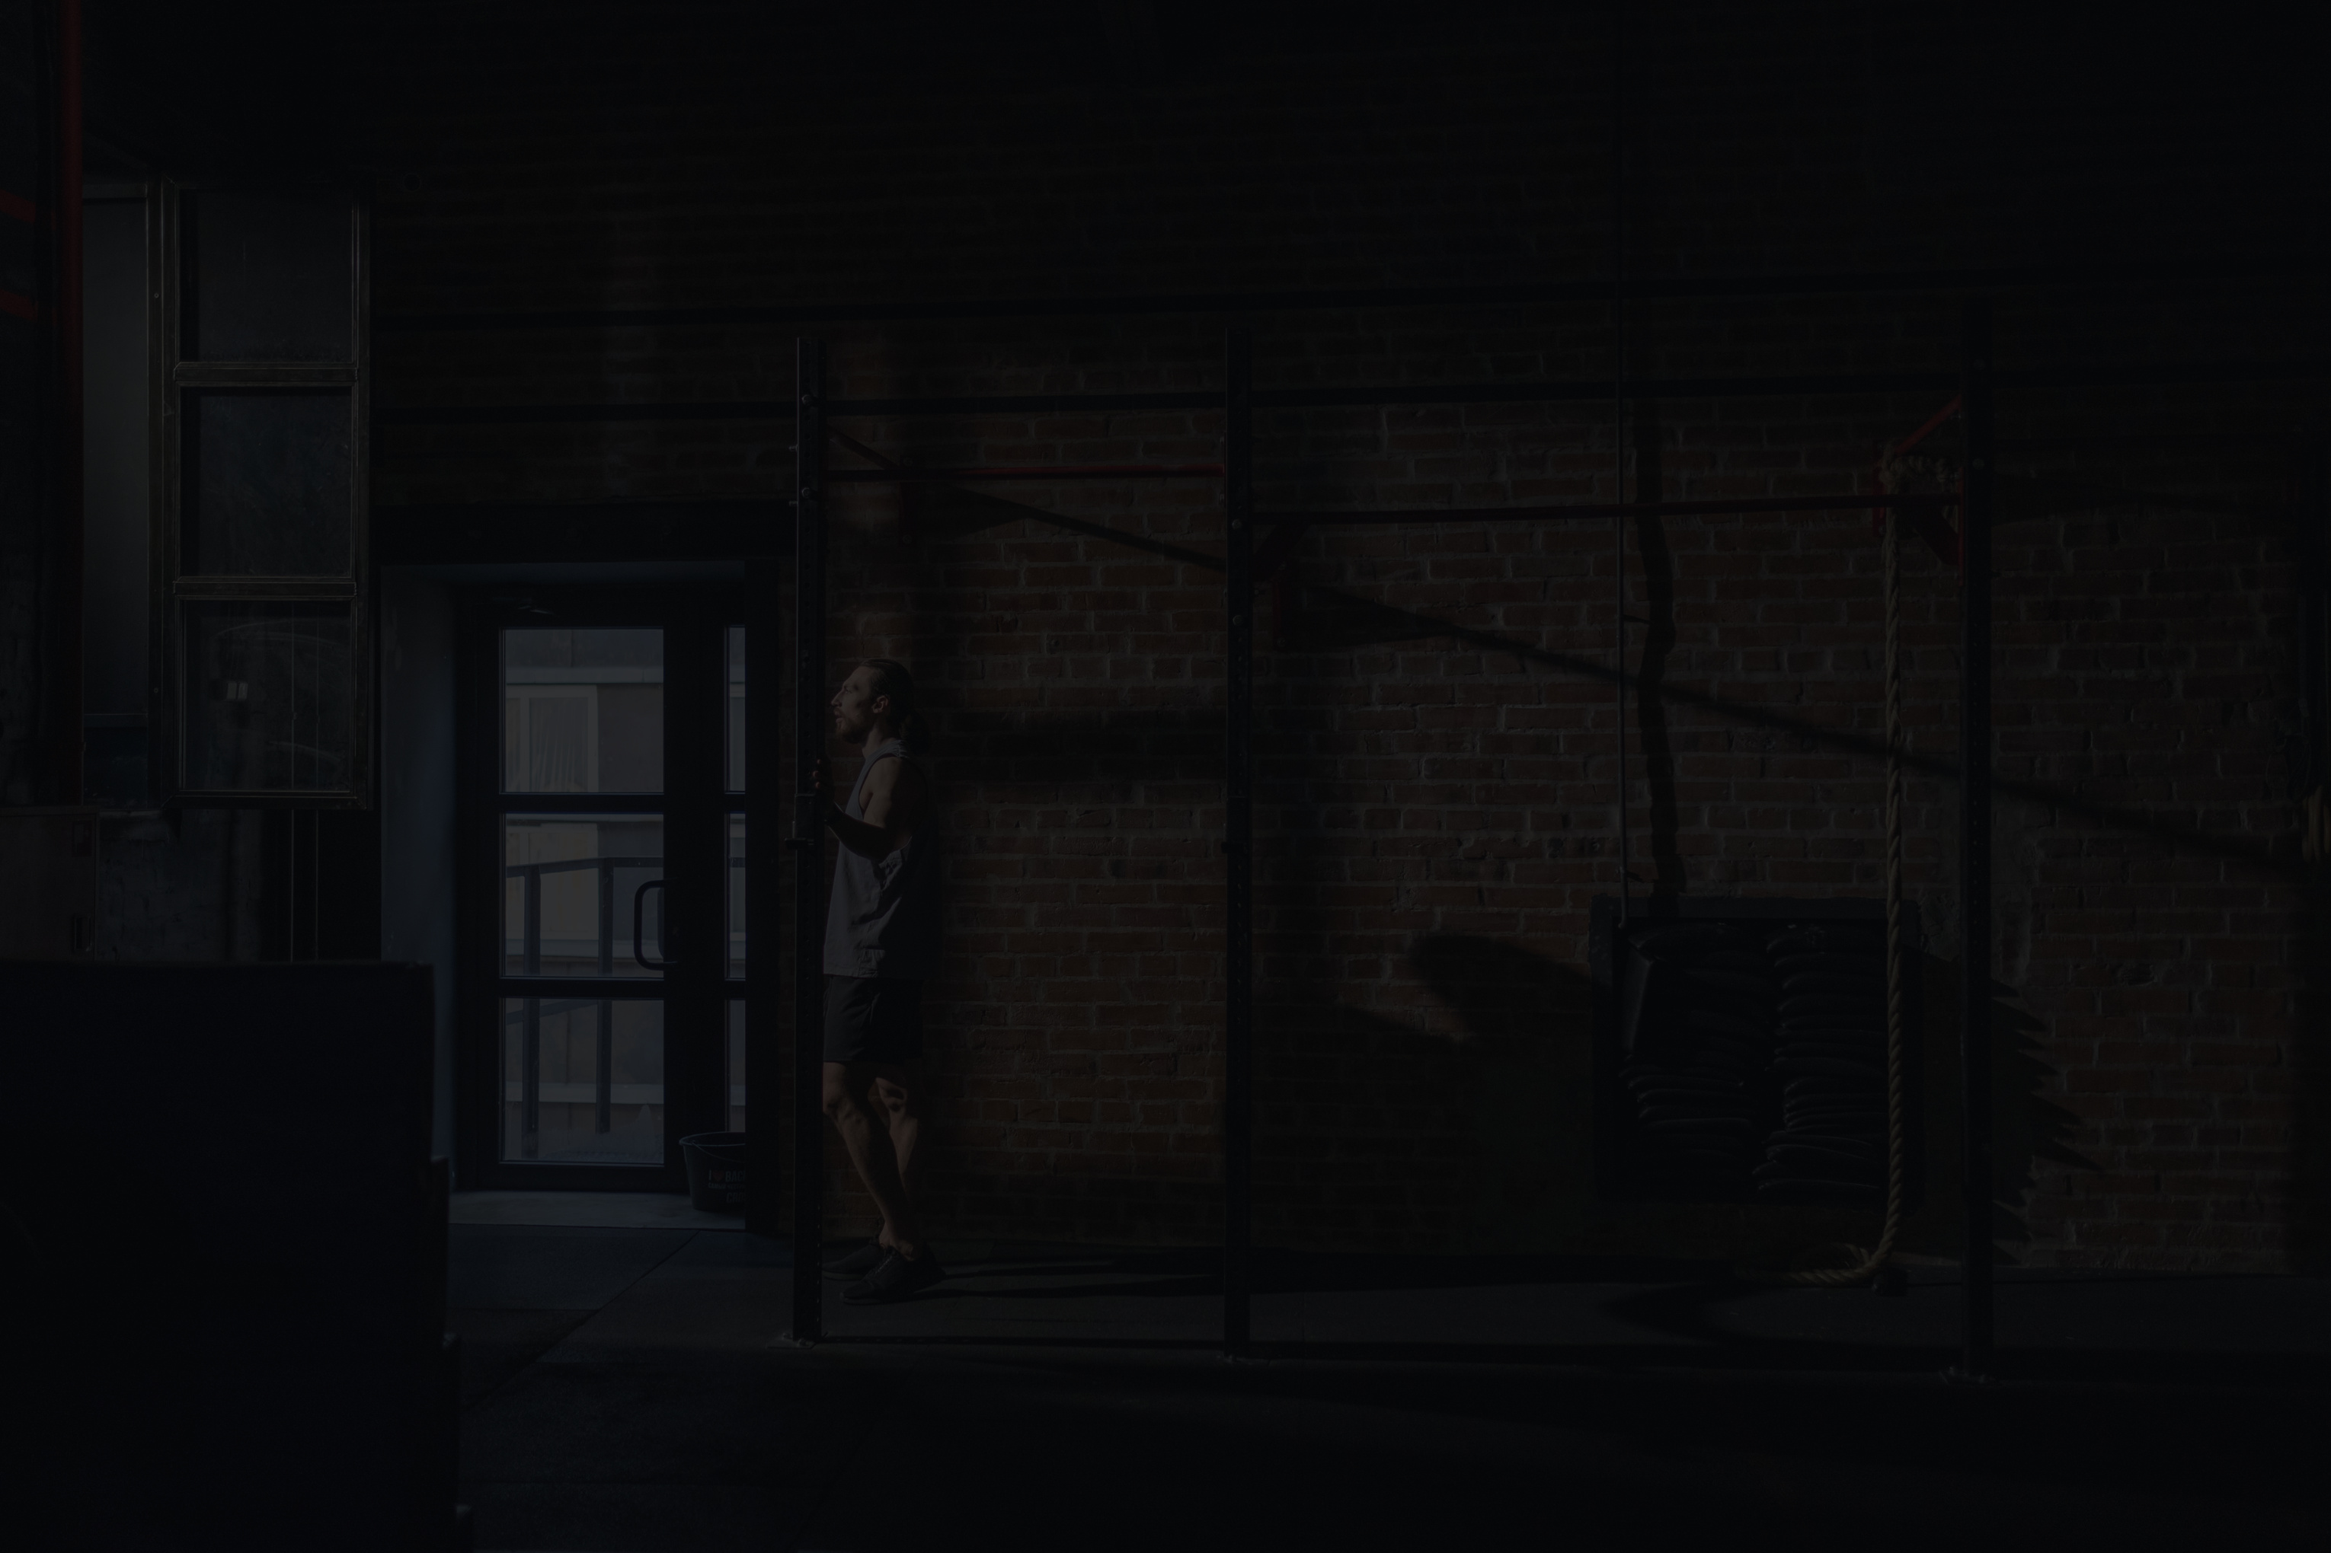
Liftology
Thank
You

